Slide 1
Microsoft Visual
C#

Slide 2




Slide 3
Looking Back
Главный язык системного программирования
99%
Достоинства: мощь, гибкость, работа с системой на низком уровне
Минусы:
Особенности программирования для Windows

Slide 4

Web Services Evolution of the Web
HTML, XML
HTML
HTML
HTML, XML
Generation 1 Static HTML
Generation 2 Web Applications
Generation 3 Web Services
Notes:
The first generation of Web applications was largely about delivering non-interactive content, i.e. publishing non-interactive HTML pages. For example, many applications simply operated in client/server mode and rendered HTML pages to send across the internet to browsers.
The second generation of Web applications was about creating applications usable over the Web. E-commerce is an example; you can go to http://www.barnesandnoble.com/ select books, order them and pay for them. This second generation also includes a more scalable back-end (e.g. WinDNA architecture) and a richer UI (e.g. DHTML and ActiveX).
However, useful though they may be, the second generation largely resulted in application islands on the Web. Yes, there are hyperlinks between sites, but for the most part, the actual applications at different sites do not interact.
The third generation of Web application is about using Web protocols and XML throughout to allow better integration between services on the Web. Protocols such as XML and SOAP allow you to create Web Services, enabling people and companies to easily create integrated applications.

Slide 5

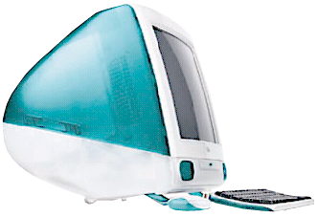

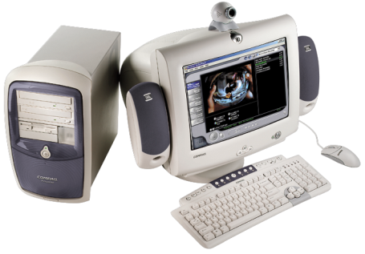

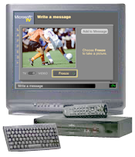



Web Services
?
?
?
?

Slide 6
Services
Windows
Web
Office
Mobile
.NET

Slide 7
COM
XML
Java
Next Generation Web Services
Notes:
Чтобы определить тип инкапсулируемого делегатом метода, необходимо объявить делегат.
На данном слайде вы видите пример, в котором объявлен делегат MyDelegate, инкапсулирующий процедуру, принимающую в качестве аргумента строку.
Далее создается экземпляр делегата, к которому "подключается" метод Hello класса MyClass.
После чего происходит обращение к этому экземпляру, в результате должен вызваться метод MyClass1.Hello с параметром "World".

Slide 8
The .NET Framework Library
One-stop, well-organized class framework
OS-independent subset submitted to ECMA
Standardization backed by Microsoft, HP, Intel
http://msdn.microsoft.com/net/ecma
Integrates all current Windows technologies
Everything in one place – for all languages
Windows Forms, GDI+, Printing for Windows Dev
Web Forms, Web Services, Networking for Net Dev
Supports Active Directory, WMI, MSMQ, Services

Slide 9
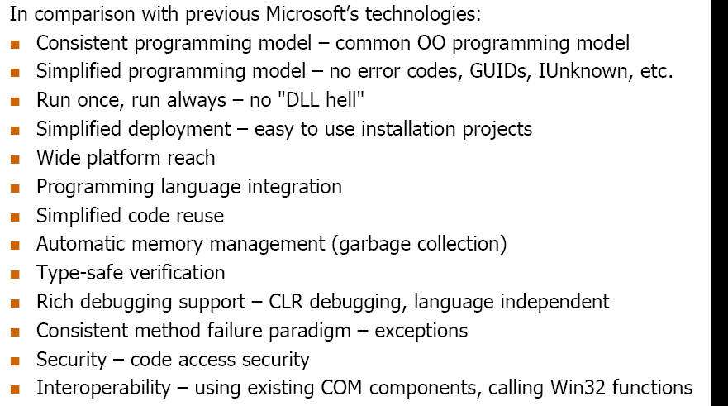
.NET

Slide 10
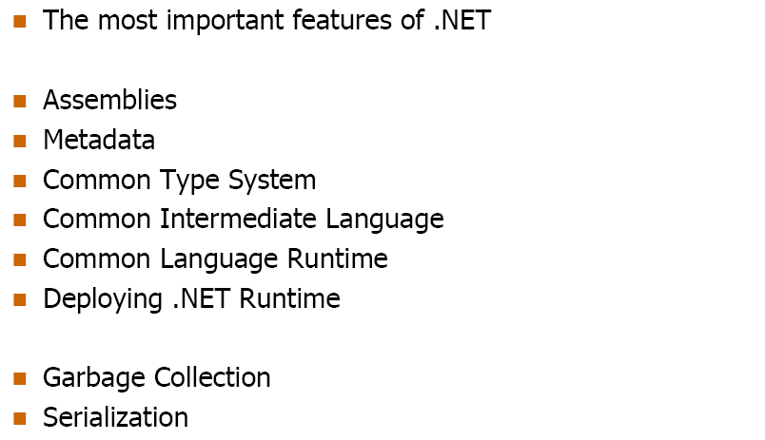
.NET

Slide 11
КОМПОНЕНТЫ .net fRAMEWORK
Visual Basic
Visual C#
Visual J#
Visual C++
Delphi
Спецификация единого языка (CLS)
Основные компоненты приложения .NET
Web
Десктоп
Web-службы
Web-Forms
Консольные приложения
Windows Forms
Базовые классы .NET Framework (BCL – Base Class Library)
ADO.NET
XML
Сеть
I/O
Службы COM+
Сообщения
Единая среда исполнения (CLR)
Управление памятью
Сборка мусора
Система типов
Служба времени выполнения

Slide 12
.NET
CLR
(Common Language Runtime)
ADO.NET (ActiveX Data Objects)
IL
(Microsoft Intermediate Language)

Slide 13
Solution (Common Language Runtime) Managed Code in Common Language Runtime
Managed Code
Common Language Runtime
Requests for existing feature
New CLR-Only Feature
Win 32 OS

Slide 14
Common Language Runtime
Highlights (managed code)
Common type system
Mapping of data types. Programming language ⇨ Framework
Just-in-time (JIT) compilers
JIT compiles intermediary language (MSIL) into native code
Highly optimized for platform or device
Garbage collector
Permission and policy-based security
Exceptions
Threading
Diagnostics and profiling

Slide 15











Compilation and Execution
Compilation
Source Code, diff lang
Language Compiler
Code (IL)
Assembly
Metadata
Native
Code
JIT Compiler
At installation or the first time each method is called
Execution
Notes:
The role of the JIT, native code cached so you only pay the JIT tax once per machine
Can use NGen

Slide 16
What is the CLR? The .NET Platform
Clients
Applications
Web Form
Web Service
.NET Framework
Protocols: HTTP, HTML, XML, SOAP, UDDI
Tools: Visual Studio.NET, Notepad
CLR
Windows
Your Internal Web Service
.NET Foundation Web Services
Third-Party Web Services
.NET Enterprise Servers
Notes:
Each blue box represents a separate computer (or cluster of computers).

Slide 17
What Is the CLR? Overview
The CLR provides a run-time environment that manages the execution of code and provides services that improves development, deploy-ment, and run time
Code that targets the CLR is called managed code
Notes:
The Common Language Runtime provides the underlying infrastructure for the .NET Framework. It provides very little application-visible functionality itself (security being a notable exception), but provides services to make development, deployment and execution much better in almost every way.

Slide 18
What Is the CLR? Goals
Development services
Deep cross-language interoperability
Increased productivity
Deployment services
Simple, reliable deployment
Fewer versioning problems – NO MORE ‘DLL HELL’
Run-time services
Performance
Scalability
Availability

Slide 19
What Is the CLR? Goal: Simpler Development
Plumbing disappears
Metadata
Transparent proxies
Memory management
Consistent exception handling
Great WYSIWYG tool support
Designers and wizards
Debuggers
Profilers
Increased productivity

Slide 20
What Is the CLR? Goal: Simpler, Safer Deployment
No registration, zero-impact install
XCOPY deployment, incremental download
Side-by-side versions of shared components
Capture version at compile time
Administrative policy at run time
Evidence-based security policy
Based on code as well as user
Code origin (location)
Publisher (public key)
DLL Hell

Slide 21
What Is the CLR? Goal: Scalability
Smart device to Web Farm
Automatic memory management
Self-configuring
Dynamically tuning
Thread pool
Asynchronous messaging
Object remoting
Events
Smart device version
Multiple RTOSes
Same tools used for desktop

Slide 22
What Is the CLR? Goal: Rich Web Clients, Safe Hosting
WinForms on the client
ASP.NET Web Forms on the server
Code is granted permissions
Evidence is used by policy to grant permissions
Application that starts runtime
Like Internet Explorer, IIS, SQL Server™, Shell
Provides some evidence
Controls code loading
Maps applications to processes

Slide 23
What Is the CLR? Goal: Converge Programming Models
COM, ASP, VB, C++
All services available
Many services redesigned
Ease of use
Scalability
Consistent API
Consistent framework raises the abstraction layer
Gradual transition from simplicity to full power
Less training, greater productivity

Slide 24
What Is the CLR? Goal: Multiple Languages
Common Type System
Object-oriented in flavor
Procedural languages well supported
Functional languages possible
CLS guides frameworks design
Rules for wide reach
All .NET Framework functionality available
Over 15 languages investigated
Most are CLS consumers
Many are CLS extenders
Choose the right language for a particular job

Slide 25
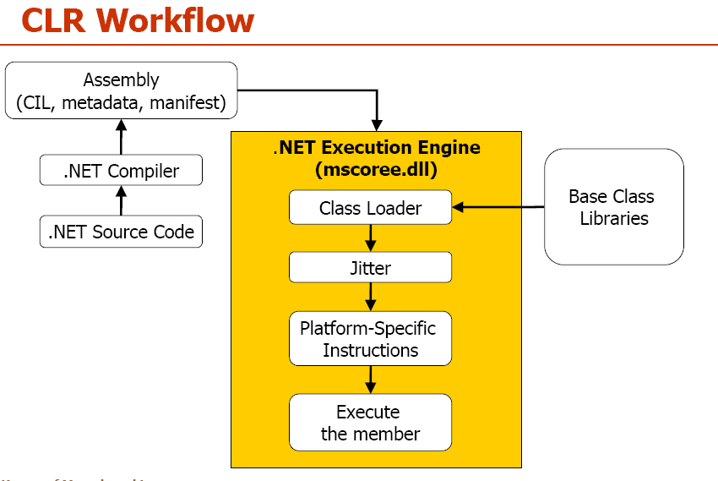

Slide 26
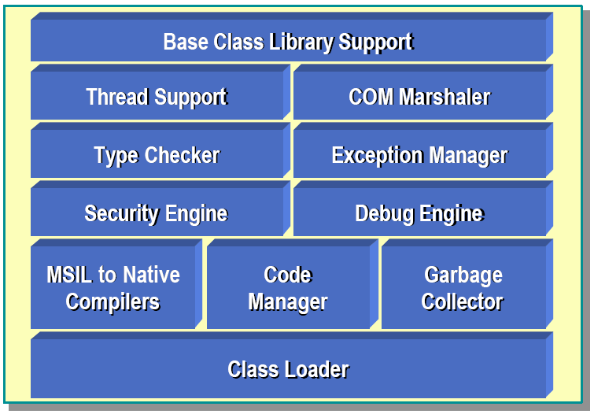
.NET: Common Language Runtime

Slide 27
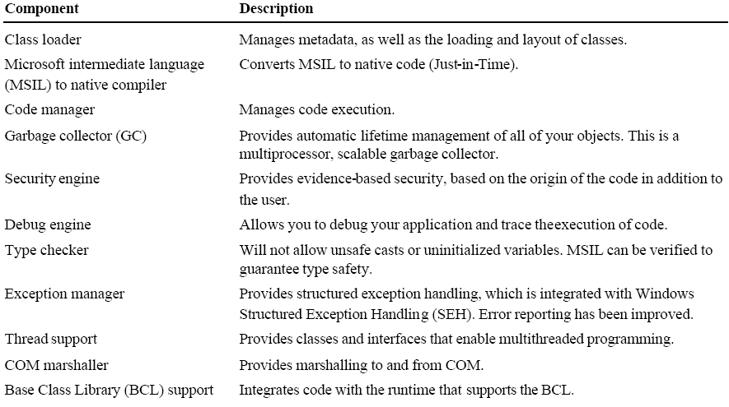
.NET: Common Language Runtime

Slide 28
Assemblies Overview
Contains code and metadata
Assemblies function as:
Unit of deployment
Type boundary
Security boundary
Reference scope boundary
Version boundary
Unit of side-by-side execution

Slide 29
Assemblies Overview
Assemblies can be:
Static: DLL, EXE
Uses existing COFF binary format
Via existing extension mechanism
Dynamic
Create assemblies with
.NET Framework SDK
Visual Studio.NET
Your own code
Dynamic assemblies

Slide 30
Assemblies Components of an Assembly
Manifest
Metadata about the assembly itself
Type metadata
Completely describes all types defined in an assembly
Managed code
Microsoft Intermediate Language (MSIL)
Resources
For example, .bmp, .jpg
Notes:
IL is always compiled, never interpreted.

Slide 31
Assemblies Components of an Assembly
ParcelTracker.DLL
Manifest
Type Metadata
MSIL
Resources
Notes:
So, what is an assembly. Simply an assembly can be thought of as a unit of deployment. Once you have compiled your source code an EXE or DLL will be created. This is the simplest form of an assembly. Inside the assembly will be found MSIL code, metadata (more on that in a moment) and resources.
Although an assembly could be thought of as a single EXE or DLL, this is not completely an accurate description. In fact a number of assemblies (for example DLLs) can be bound into one assembly (multi file assembly). In some instances this makes deployment much more simple in that all of the required components are bundled into one binary file. To achieve this we would use the assembly linker tool AL.EXE. However, in some situations the fact that assemblies are contained within separate files is of course a great advantage e.g. Web based applications where only those assemblies that are required are downloaded.

Slide 32
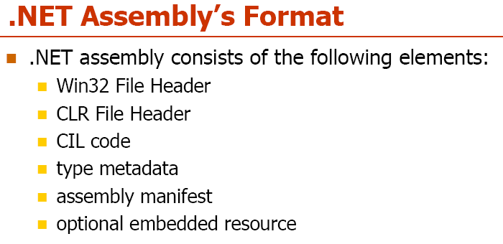
.NET: Common Language Runtime

Slide 33
Assemblies Components of an Assembly
An assembly is a logical unit, not physical
It can consist of multiple modules (.DLL, .JPG, etc.)
Assembly
Module
In this figure, containment implies a 1:M relationship
File
Type

Slide 34
Assemblies Components of an Assembly
A single-file assembly
A multi-file assembly
File1.dll
File2.dll
Graphic.jpg
Logo.gif
Manifest Metadata
MSIL
Metadata
MSIL
Resource
Resource
File3.dll
Manifest

Slide 35
Assemblies Assembly Generation Tool: al.exe
Takes one or more files (containing either MSIL or resource files) and produces a file with an assembly manifest.
When compiling a C# file, you can specify that it create a module instead of an assembly by using /target:module.

Slide 36
Assemblies Manifest
Manifest contains:
Identity information
Name, version number, culture, strong name
List of files in the assembly
Map of assembly types to files
Dependencies
Other assemblies used by this assembly
Exported types
Security permissions needed to run

Slide 37
Assemblies Manifest and Metadata
Type Descriptions
Name
Version
Culture
Manifest
Other assemblies
Security Permissions
Exported Types
Assembly Description
Classes
Base classes
Implemented interfaces
Data members
Methods
Metadata
Notes:
So, if we could use magic to look inside an assembly, what information would we find?
Assembly Contents
BUILD: Type Information
Obviously one of the most important bits of information found within an assembly is the type information that we discussed on the previous slide.
BUILD: Assembly Description
Name – Simply the name of the assembly. Used in assembly resolution. This name is the same as the assembly file name minus the extension.
Version No (Compatibility No) – Used by CLR at runtime. Broken down into three sub-values
Incompatible – If this value does not match the required version there is an incompatibility. E.g. This later version of the component is not backwardly compatible.
Maybe compatible – If this value does not match the required version, some changes that are deemed not to break existing clients have been made (therefore should be compatible)
Revision - Minor changes (should not effect compatibility in any way).
Note : A 4th value does exist. This 4th value is the build No of the component
Culture - may be culture independent or independent. Allows correct assembly to be used or correct resources for assemblies with different resources for different cultures.
BUILD
Other Assemblies – Information regarding what other assemblies are required by this assembly. Just like EXE modules in WIN32 list those DLLs that need to be imported.
Security –
Note: Assemblies may be signed by software publishers using the standard AuthentiCode signing tools. For more info, see Windows Platform SDK – http://msdn.microsoft.com/library/sdkdoc/crypto/cryptotools_0bl1.htm

Slide 38
Assemblies What’s In the Metadata
Description of types
Name, visibility, base class, interfaces implemented
Members
methods, fields, properties, events, nested types
Attributes
User-defined
Compiler-defined
Framework-defined

Slide 39
Execution Model Create Assembly
Source Code
Assembly
Compiler
C++, C#, VB or any .NET language
csc.exe or vbc.exe
DLL or EXE
Notes:
As a developer you can write code in the language of your choice. Your code is compiled into an Assembly, which is represented as a DLL or EXE.

Slide 40
Assemblies Demo: ILDASM.EXE
Allows you to inspect the metadata and disassembled IL code in an assembly
Great way to see what’s really going on
Use ildasm /? to see the various options

Slide 41
Assemblies Metadata
Key to simpler programming model
Generated automatically
Stored with code in executable file (.dll or .exe)

Slide 42
Assemblies Metadata: Creation and Use
Reflection
Source
Code
Serialization
(e.g. SOAP)
Designers
Compiler
Other
Compiler
Debugger
Assembly
(Manifest, metadata
and code)
Type Browser
Profiler
Schema
Generator
Proxy Generator
XML encoding
(WSDL)

Slide 43
Assemblies Compilers Use Metadata
For cross-language data type import
Emit metadata with output code
Describe types defined and used
Record external assemblies referenced
Record version information
Custom attributes can be used
Obsolete
CLS compliance
Compiled for debugging
Language-specific markers

Slide 44
Assemblies Other Tools Use Metadata
Designer behavior
Controlled by user-supplied attributes
Category
Description
Designer extensibility
User-supplied attributes specify code to use
Type converters
Editors
Web methods marked by custom attribute
Type viewer

Slide 45
Assemblies Global Assembly Cache
A set of assemblies that can be referenced by any application on a machine
Should be used only when needed
Private assemblies are preferred
Located at %SystemRoot%\assembly
Add assemblies by
Installer program
gacutil.exe
Windows Explorer
Assembly Cache Viewer (shfusion.dll) is a shell extension for GAC that is installed with the .NET Framework SDK
.NET Framework Configuration Tool (mscorcfg.msc)
Assembly must have a strong name

Slide 46
Assemblies MSIL
Microsoft Intermediate Language
.assembly hello {}
.assembly extern mscorlib {}
.method static public void main() il managed {
.entrypoint
.maxstack 1
ldstr "Hello World from IL!"
call void [mscorlib]System.Console::WriteLine(class
System.String)
ret
}

Slide 47
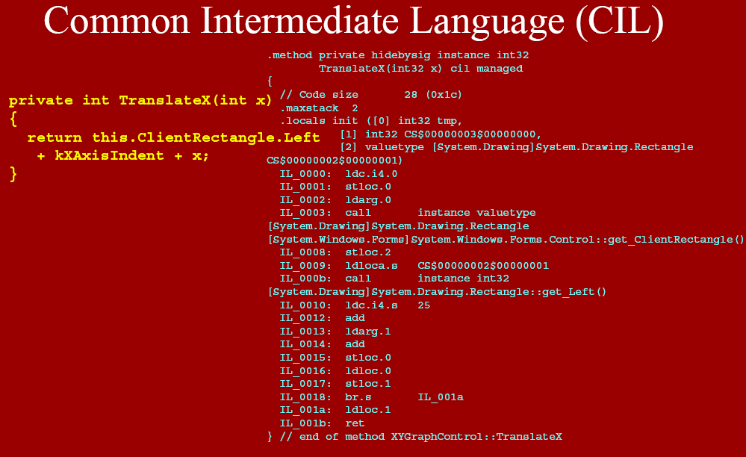

Slide 48
Assemblies MSIL
Compiled with ilasm.exe
MSIL was designed for the CLR
Object-oriented (primitives are not special)
Designed for the Common Type System
Does not embed type information
See documentation in C:\Program Files\Microsoft Visual Studio .NET\FrameworkSDK\Tool Developers Guide\docs

Slide 49


Slide 50
VB
C++
C#
Perl
Python
…
Common Language Runtime
Manages running code
Fine-grained evidence-based security
No-touch deployment
Object remoting with SOAP
Web Services
User Interface
Framework Classes
Spans all programming languages
Object-oriented and consistent
Common type system built-in
Extensible
Secure
ASP.NET
ADO.NET
Build data-driven applications using XML
Program against your objects
Easily pass data across the wire and between platforms with XML
Relational and unstructured data
ADO.NET: Data and XML
Base Framework
Common Language Runtime
MSMQ
(Message
Queuing)
COM+
(Transactions, Partitions,
Object Pooling)
IIS
WMI
Win32

Slide 51
Solution (Microsoft Intermediate Language) Different Languages are Compiled into MSIL
Development tools
Just-In-Time
compiler
Source code :
Any languages
MS Intermediate
Language
Platform specific
code

Slide 52
Assembly
A logical collection of one or more exe and dll file containing an application’s code and resources
It contains
1-Codes in MSIL
2-Manifest
A metadata description of the code and resources

Slide 53
Metadata
What classes and method it contains
What external objects it requires
What version of code it represents

Slide 54
Manifest example (TimeComponent.dll)
.assembly extern mscorlib
{
.publickeytoken = (B7 7A 5C 56 19 34 E0 89 ) // .z\V.4..
.ver 1:0:2411:0
}
.assembly extern Microsoft.VisualBasic
{
.publickeytoken = (B0 3F 5F 7F 11 D5 0A 3A ) // .?_....:
.ver 7:0:0:0
}
.assembly TimeComponent
{
.hash algorithm 0x00008004
.ver 0:0:0:0
}
.module TimeComponent.dll
// MVID: {144ACC38-E825-45C4-83A6-C2A9E5A901DD}
.imagebase 0x00400000
.subsystem 0x00000002
.file alignment 512
.corflags 0x00000001
// Image base: 0x032a0000

Slide 55
Versioning
DLL Hell
Replacing a DLL used by an existing client, with a newer version (or vice versa)
.NET provides a standard way to specify
version
Each client assembly uses its own specified versions of related assemblies

Slide 56
Interoperability Managed/Unmanaged
.NET provides interoperability mechanism to permit managed code to call into unmanaged code and vice versa
Why?
Existing code works, why rewrite it?
Calling Microsoft functionality not yet available as .NET assemblies
For example, OLEDB server-side cursors
Calling 3rd party native code
Migrate your code incrementally

Slide 57
Interoperability Managed/Unmanaged
Managed
Unmanaged
C#
VB
MFC/ATL
VB
MSVCRT
Delphi
C++

Slide 58
Interoperability Managed/Unmanaged
.NET Framework
Type standard
Assemblies
Resilient
Type safe
Object based
Exceptions
Strong names
COM/DLL
Binary standard
Type libraries
Immutable
Type unsafe
Interface based
HResults
Guids

Slide 59
Interoperability Managed/Unmanaged
.NET provides two mechanisms for interoperability between managed and unmanaged code:
P/Invoke – Platform Invocation
COM integration

Slide 60
Interoperability P/Invoke
Provides access to static entry points in unmanaged DLLs
Similar to:
VB Declare statement
C/C++ LoadLibrary / GetProcAddress
Requires method definition with custom attribute
Marshalls data across the boundary

Slide 61
Interoperability P/Invoke
Class Win32API
<DllImport(“User32.dll”, EntryPoint:=“MessageBox”)> _
Public Shared extern Boolean MsgBox(…)
End Class

Slide 62
Interoperability P/Invoke
<StructLayout(LayoutKind.Sequential)>
Structure OSInfo
uint MajorVersion
uint MinorVersion
String VersionString
End Structure
Class Win32API
<DllImport(“User32.dll”)>
public static extern Boolean GetVersionEx(OSInfo osi)
End Class

Slide 63
Interoperability P/Invoke
Transitions have overhead
Roughly 20-30 instructions per call
Data marshaling adds additional overhead
Depending on type and size of data
Isomorphic types (char, int, float, long, double, etc.) are cheap
Make transitions wisely
Chunky calls as opposed to chatty

Slide 64
Interoperability COM Integration
What is COM?
What is the relationship between the CLR and COM?

Slide 65
Interoperability What Is COM?
Application
Code and data structures
Before COM, applications were completely separate entities with little or no integration

Slide 66
Interoperability What Is COM?
COM provides a way for components to integrate. However, each component must provide the “plumbing” and objects cannot directly interact.

Slide 67
Interoperability COM Integration
With the .NET Framework Common Language Runtime, components are built on a common substrate. No “plumbing” is needed and objects can directly interact.

Slide 68
The .NET Framework .NET Framework Classes
System.Web
System.Windows.Forms
Services
UI
Form
Button
Description
HtmlControls
MessageBox
ListControl
Discovery
WebControls
Protocols
System.Drawing
Caching
Security
Drawing2D
Printing
Configuration
SessionState
Imaging
Text
Same classes for all languages!!!
System.Data
System.Xml
OLEDB
SQL
XSLT
Serialization
Design
SQLTypes
XPath
System
Collections
IO
Security
Runtime
Configuration
Net
ServiceProcess
InteropServices
Diagnostics
Reflection
Text
Remoting
Globalization
Resources
Threading
Serialization
Notes:
This is but a brief illustration of the breadth of classes provided by the .NET Framework. We will explore many of these classes during this course.
All of these classes are available to ALL languages.

Slide 69
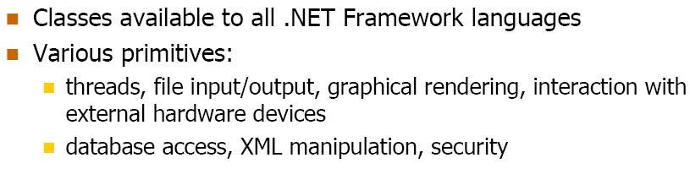
.NET: Base Class Library

Slide 70
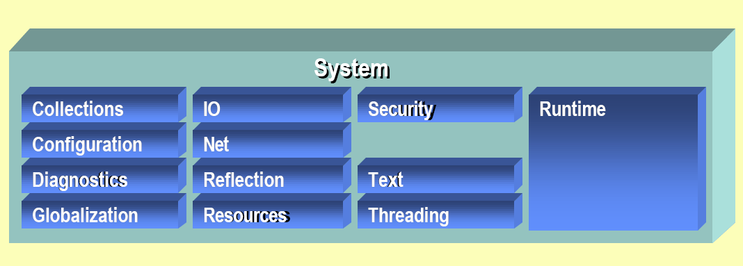
.NET: Base Class Library

Slide 71
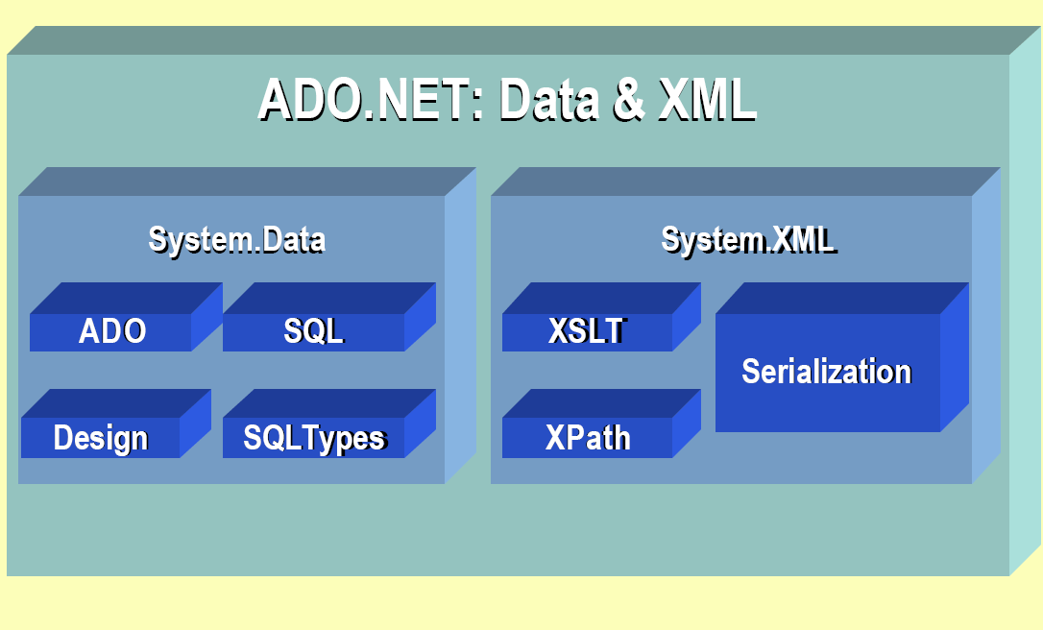
.NET: ADO.NET: Data and XML

Slide 72
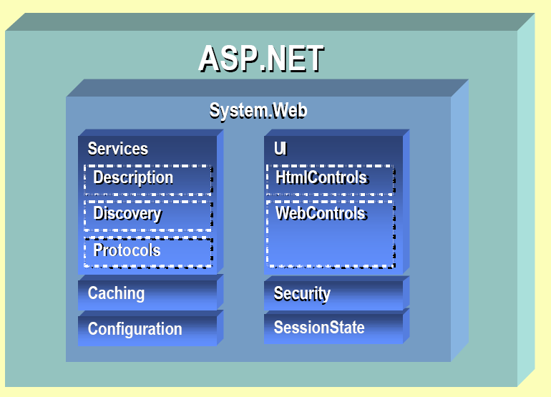
.NET: Web Forms and Services

Slide 73
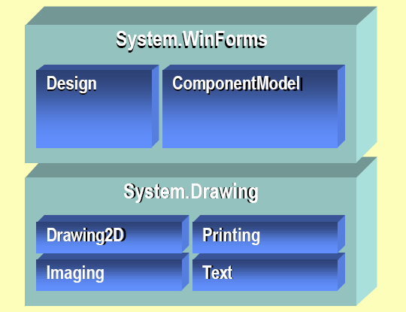
.NET: User Interface for Windows

Slide 74
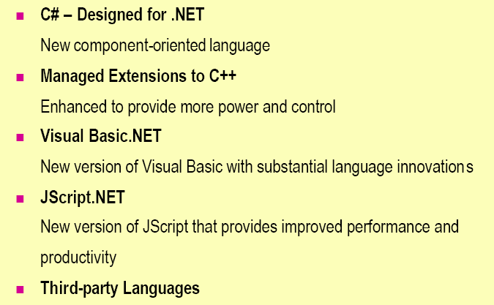
.NET: Languages

Slide 75
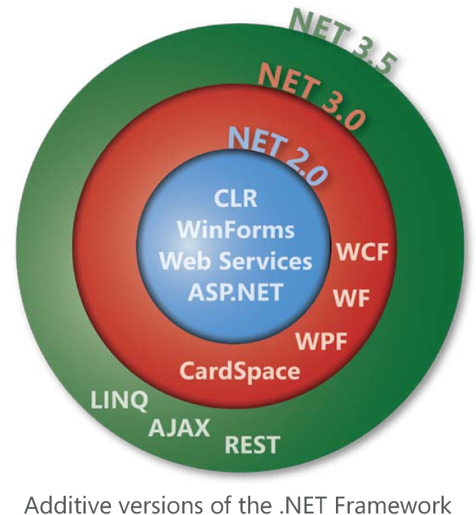

Slide 76
WinFX
WCF - Windows Communication Foundation
WPF - Windows Presentation Foundation
+ XAML
Microsoft Expression Studio
WWF - Windows Workflow Foundation

Slide 77
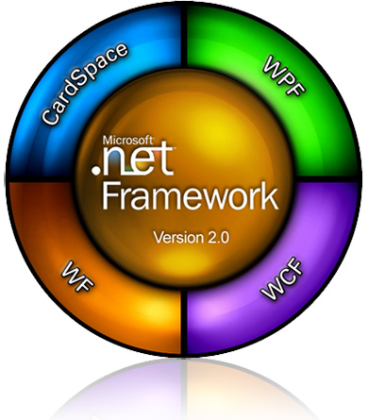
.NET: evolution

Slide 78


Slide 79
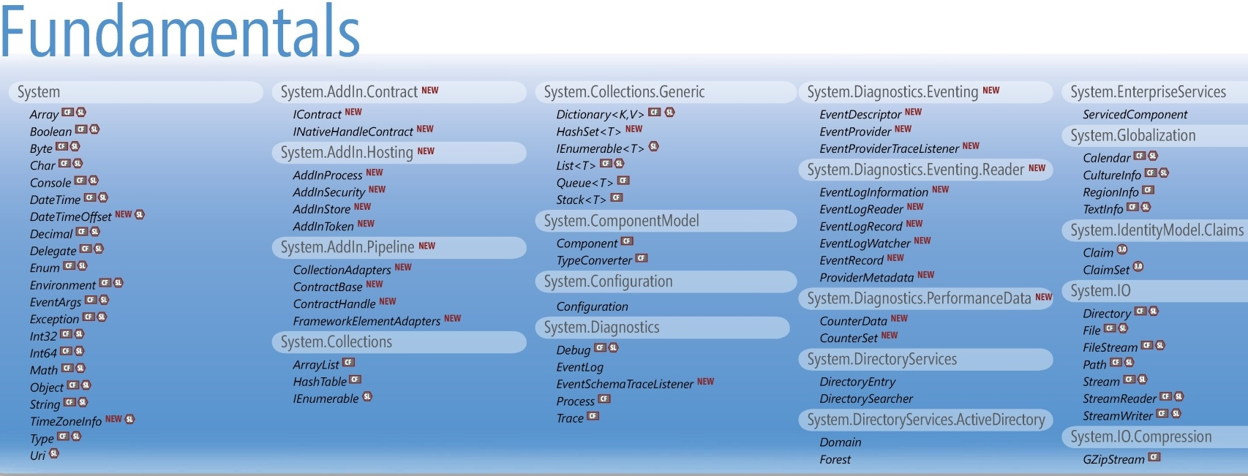

Slide 80
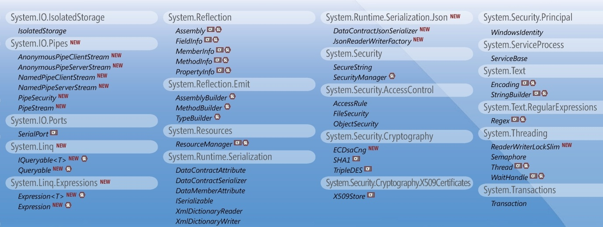

Slide 81
Security Design Goals
Provide a robust security system for partially-trusted, mobile code
Make it easy to:
Express fine-grained authorizations
Extend and customize the system
Perform security checks in user code
No end-user UI!
Never ask a user to make a security decision “on the fly”

Slide 82
Security Code Verification
Code can only perform legal operations
Encapsulation boundary is preserved
Can only call the exposed methods
No buffer overruns

Slide 83
Security Code Access Security
Code may require permissions to run
Security policy determines what code is allowed to run
By machine
Where did this code come from?
Who authored it?
By user
If no permission then a SecurityException is thrown

Slide 84
Security Code Access Security
Can specify the permissions needed by code
Declarative, with attributes
Imperative
See permissions classes in the namespace: System.Security.Permissions
Create a permission object, then call Demand()
By default, the CLR will ensure that all code in call chain has the necessary permissions

Slide 85
Security Code Access Security
Security check
Varying levels of trust
Behavior constrained by least trustworthy component
Call Chain
Assembly A1
G1
P
Assembly A2
G2
P
Assembly A3
G3
P
Assembly A4
G4

Slide 86
Security Code Access Security
Can override security checks
Assert() lets you and the code you call perform actions that you have permission to do, but your callers may not.
Deny() lets you prevent downstream code from performing certain actions
PermitOnly() is like Deny(), but you specify the only permissions the downstream code will have.

Slide 87
Security Permissions
Permission and permission set
XML representation of permissions
Code access permissions
Protect resources and operations
Identity permissions
Characteristics of an assembly‘s identity
Role-based permissions
Discover a user‘s role or identity
Custom permissions
Design and implement your own classes

Slide 88
Security Policy
Process of determining permissions to grant to code
Permissions granted to code, not user
Grants are on a per-assembly basis
Multiple levels of policy
Machine-wide, user-specific by default
Further restrictions allowed on a per application-domain basis

Slide 89
Security Policy
Each policy level is a collection of code groups
Code has identity in the runtime, just like users have identity in OS
Permissions are associated with each code group
Evidence determines group membership
In the group, get granted the related permissions
All Code
P
Publisher:
Microsoft
Zone:
Internet
Zone:
Local Intranet
Site:
XYZ.COM
P
P
P
P
Name:
MS.Office
Name:
MS.Money
Publisher:
Corp. Admin
Site:
localweb
P
P
P
P

Slide 90
Security Policy
Policy levels: machine, user, application domain
user
machine
Resulting
permission set
appdomain

Slide 91
Security Tools
Code access security tool
caspol.exe
Managing certificates
cert2spc.exe, certmgr.exe, makecert.exe, chktrust.exe
Managing assemblies
Shared Name utility: Sn.exe
Global Assembly Cache utility: gacutil.exe
permview.exe
View permissons requested by an assembly

Slide 92
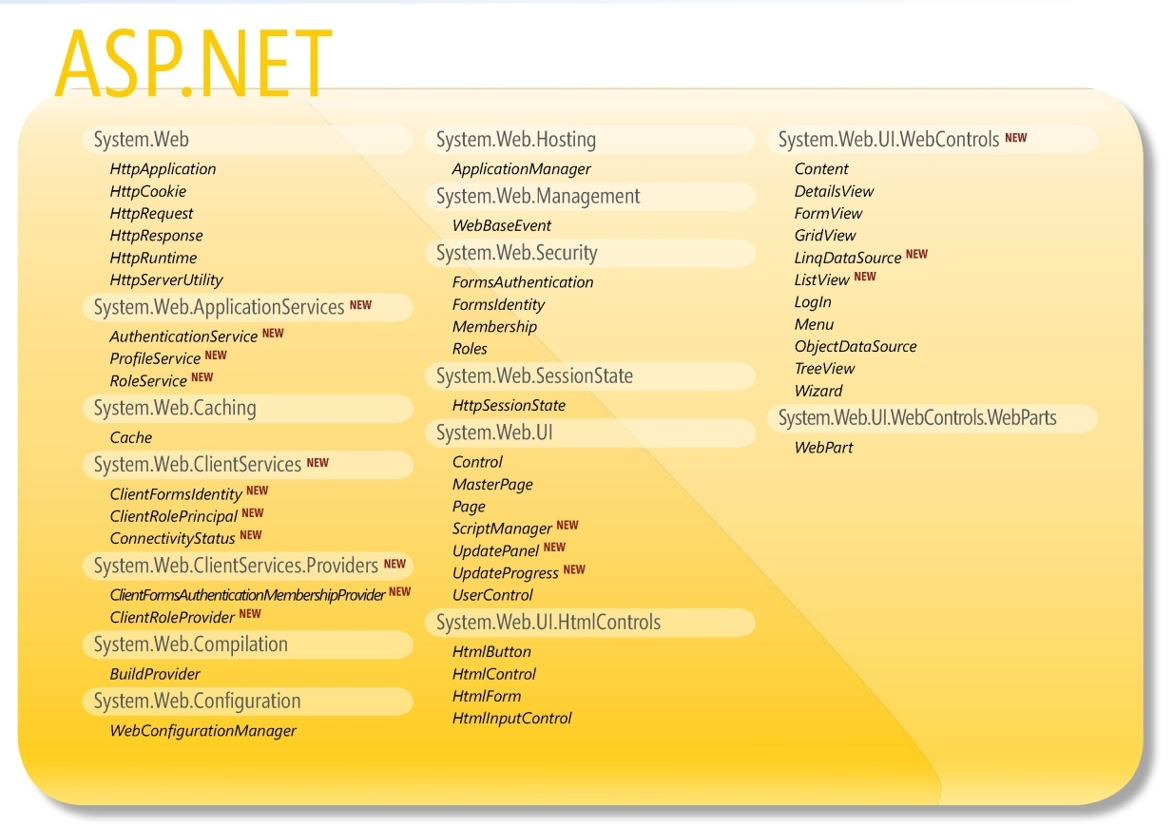

Slide 93
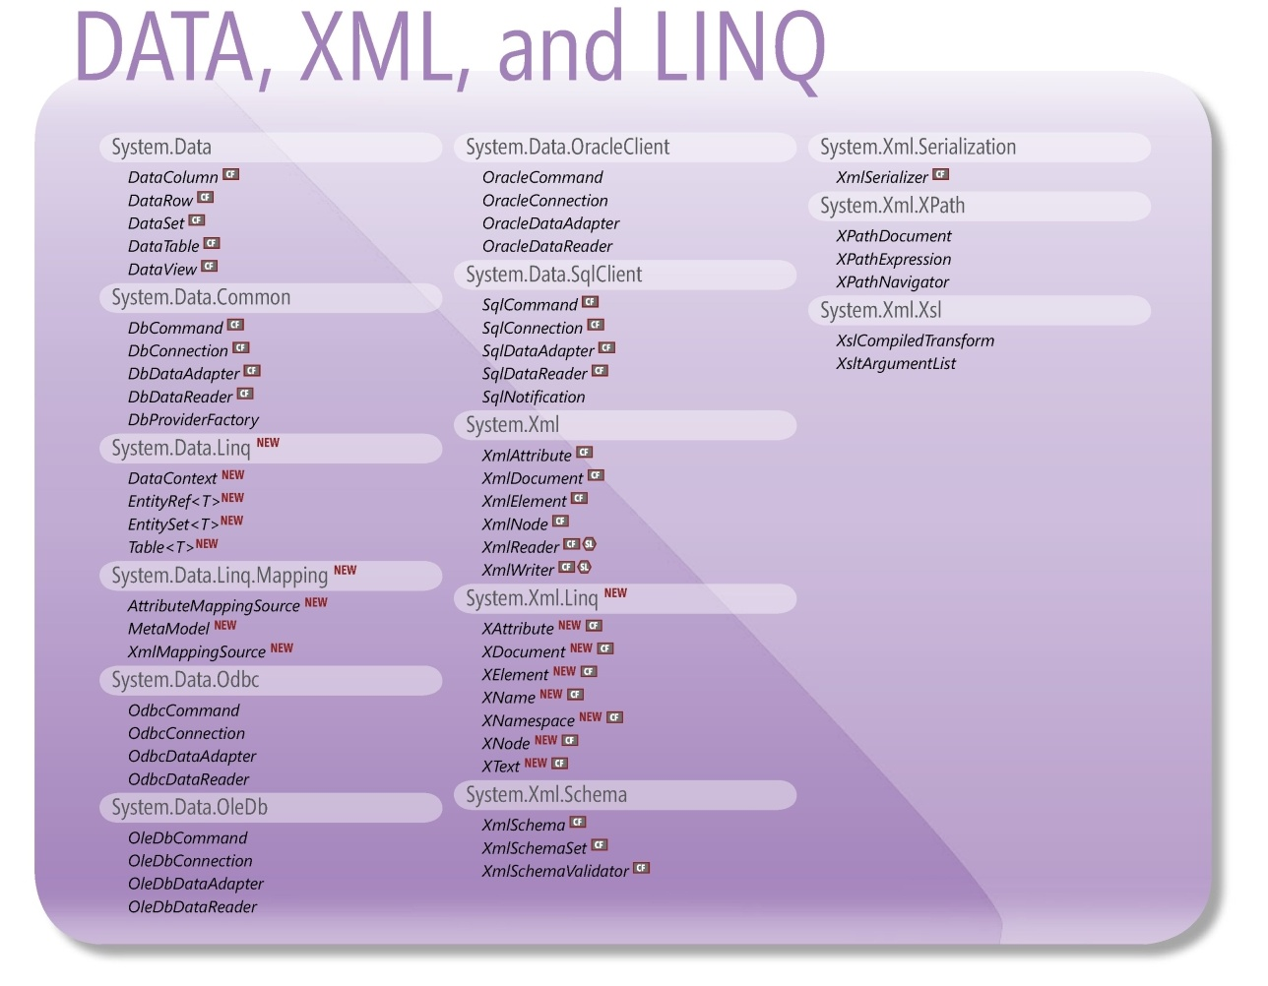

Slide 94
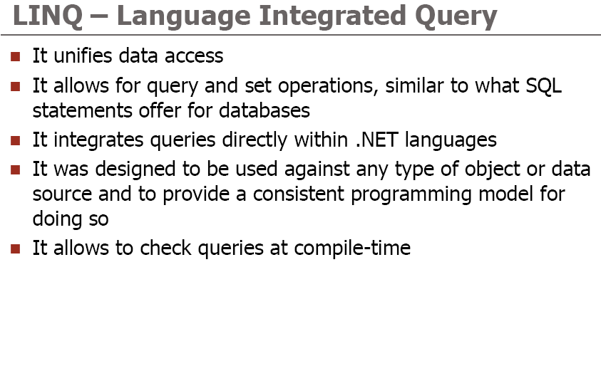
.NET: LINQ

Slide 95
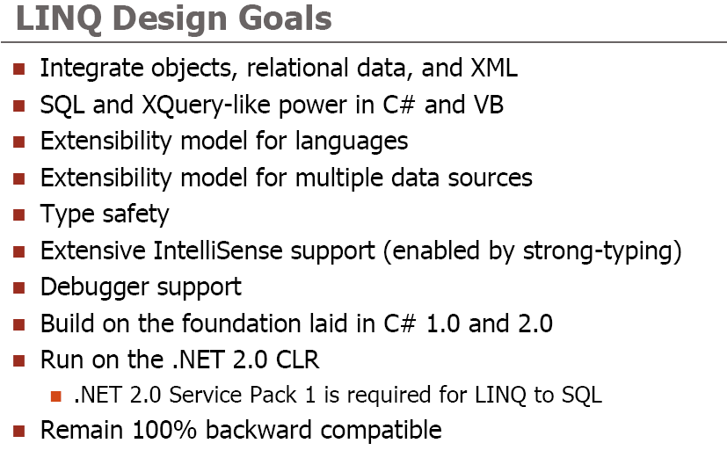
.NET: LINQ

Slide 96
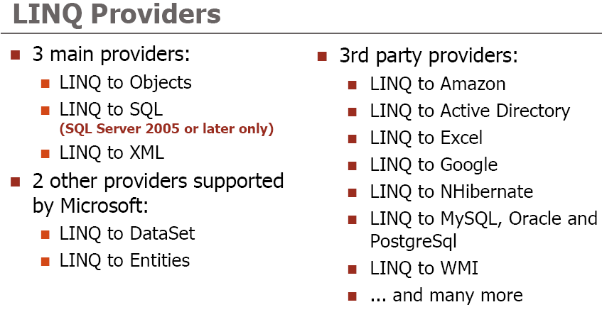
.NET: LINQ

Slide 97
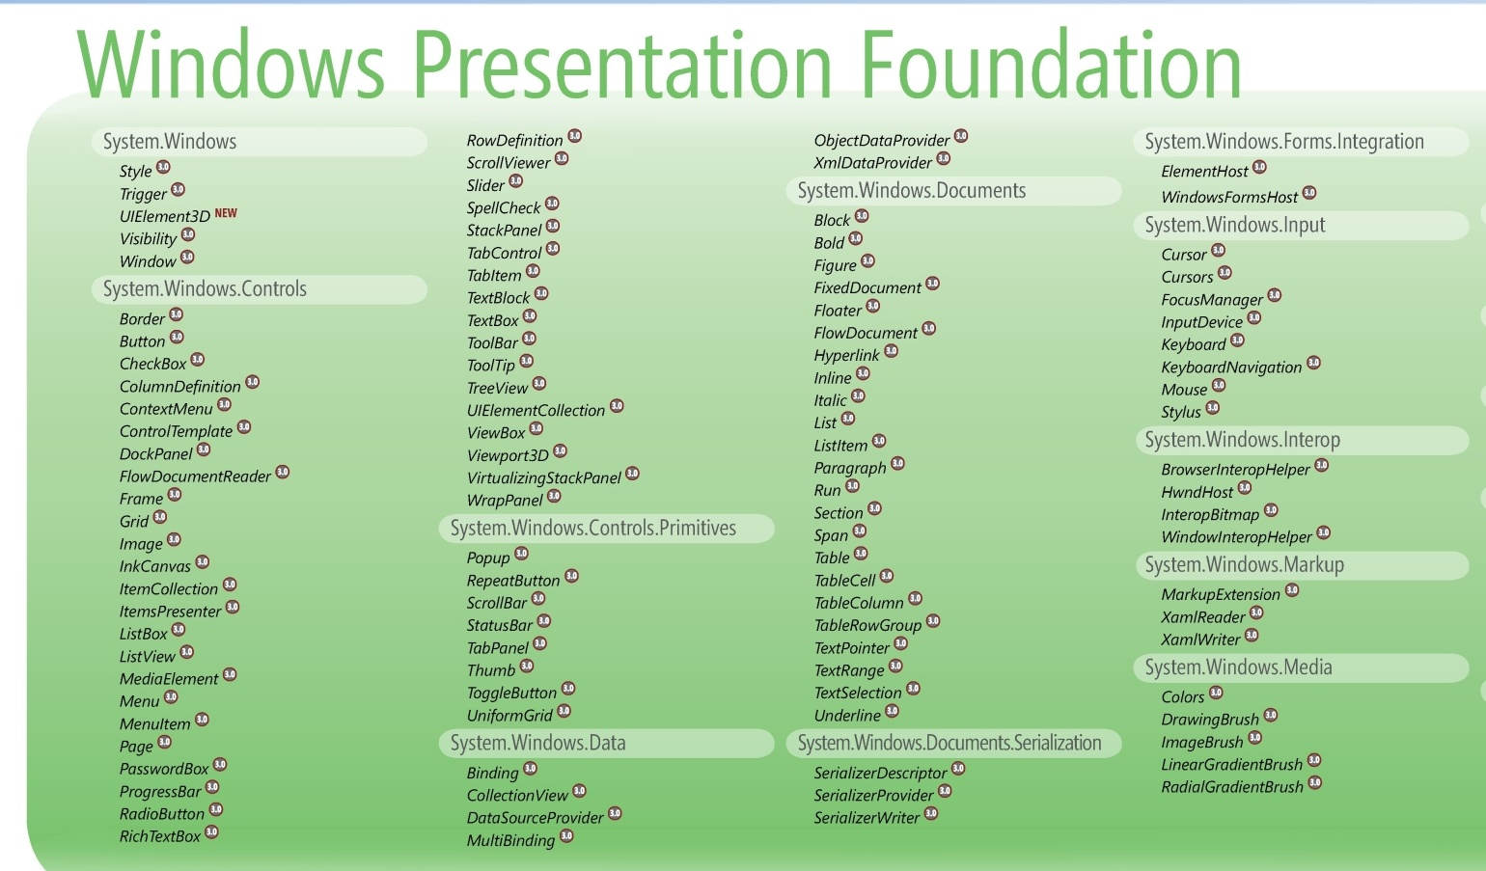

Slide 98
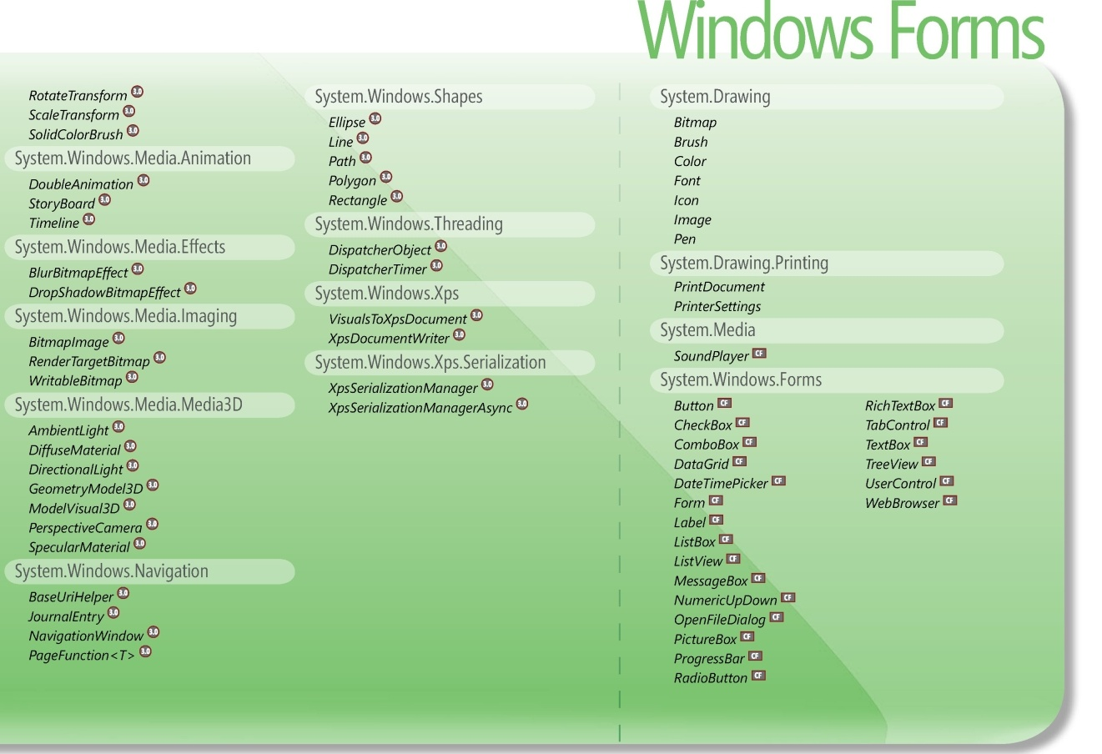

Slide 99
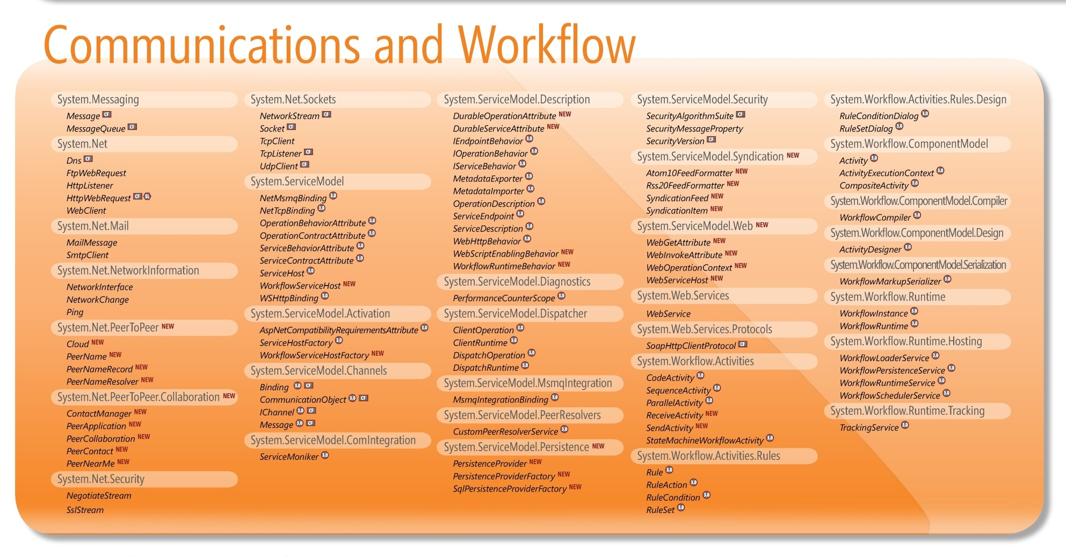

Slide 100
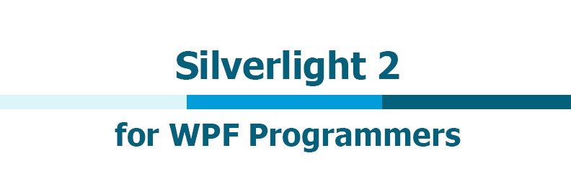

Slide 101
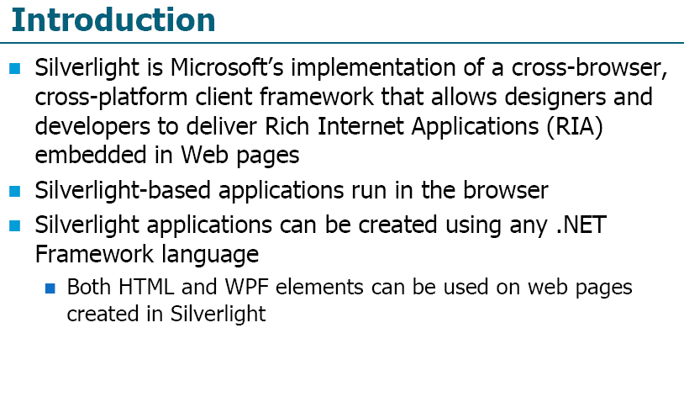
.NET: Silverlight

Slide 102
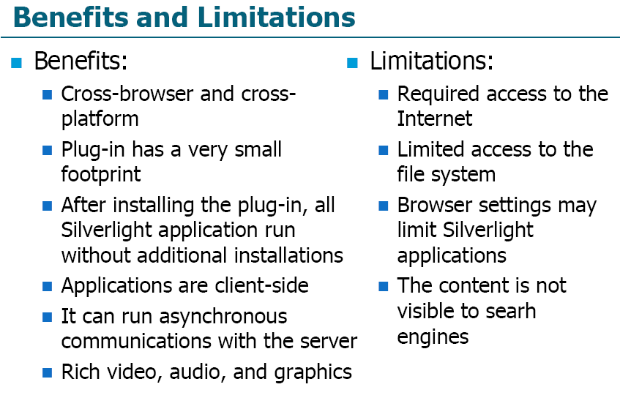
.NET: Silverlight

Slide 103
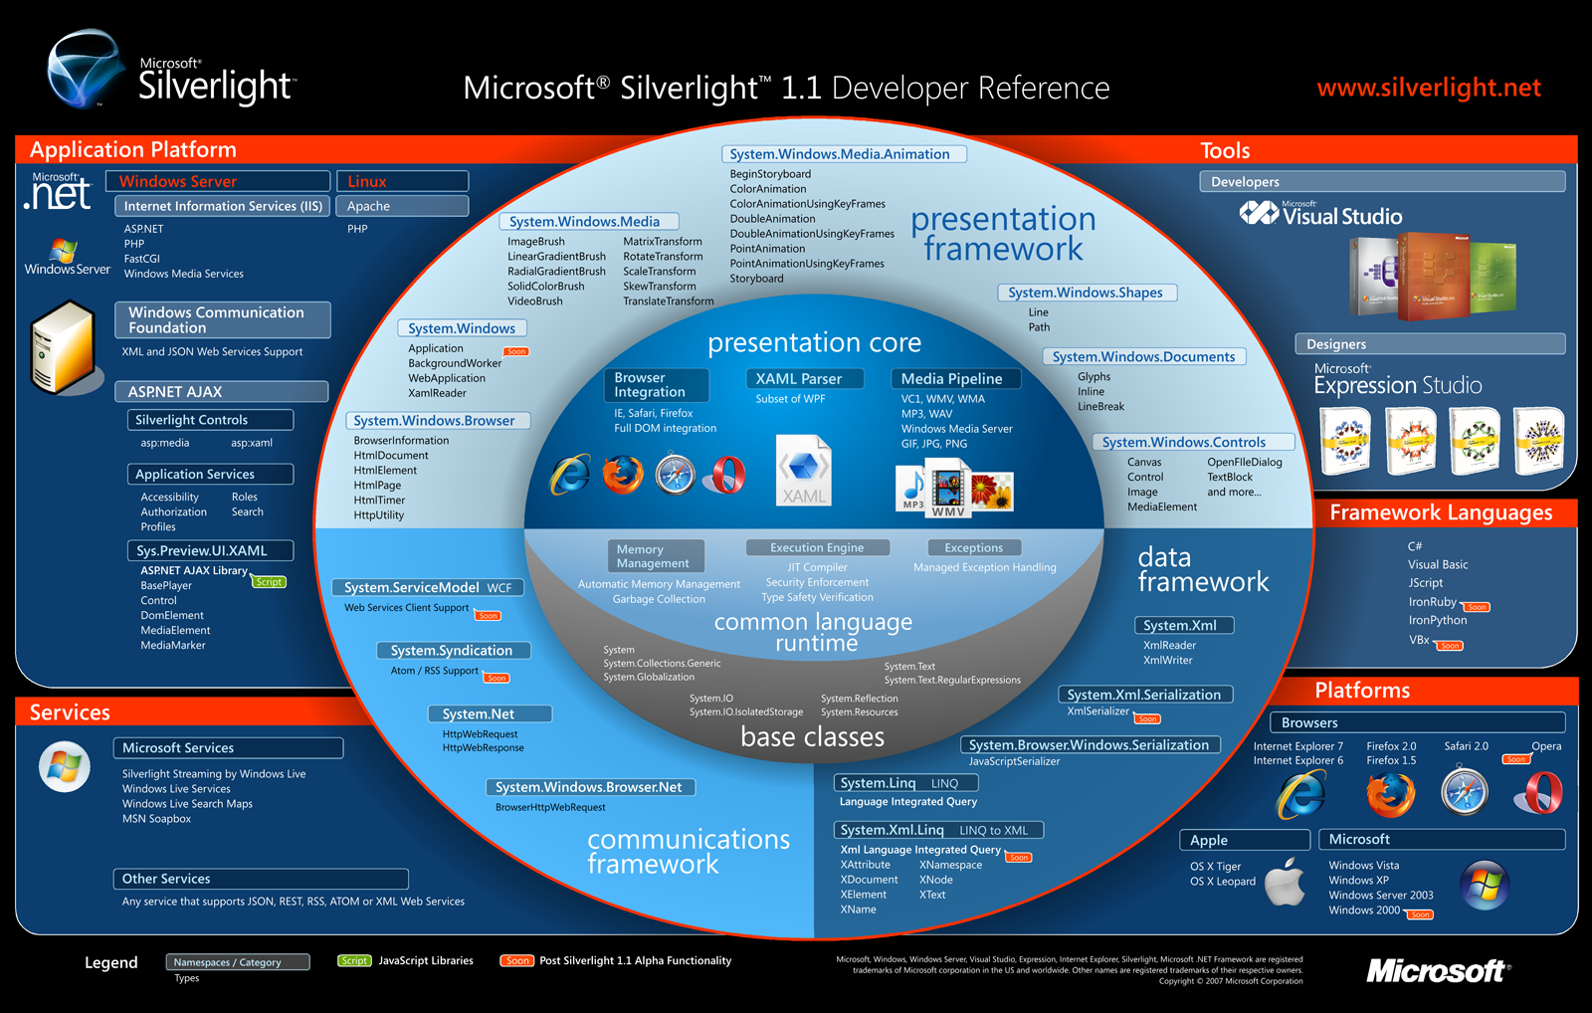

Slide 109
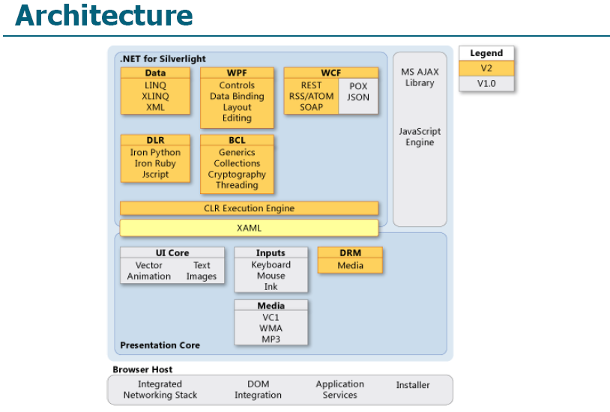
.NET: Silverlight

Slide 110
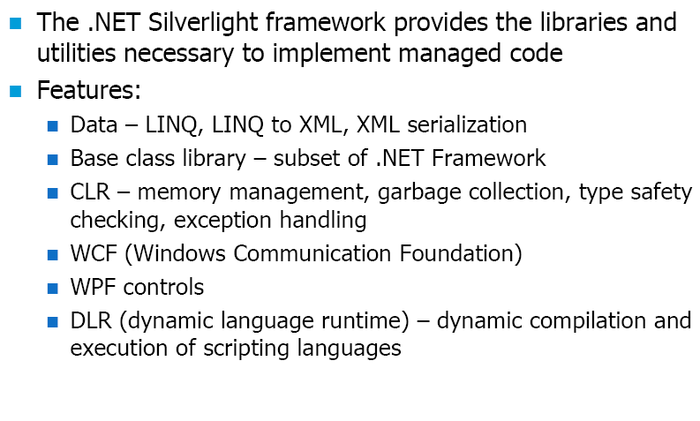
.NET: Silverlight

Slide 111
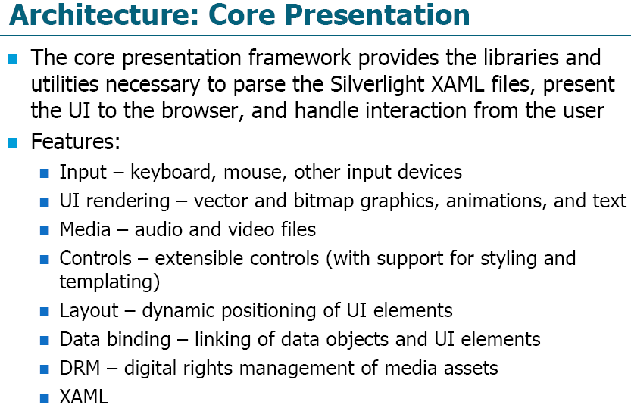
.NET: Silverlight

Slide 112
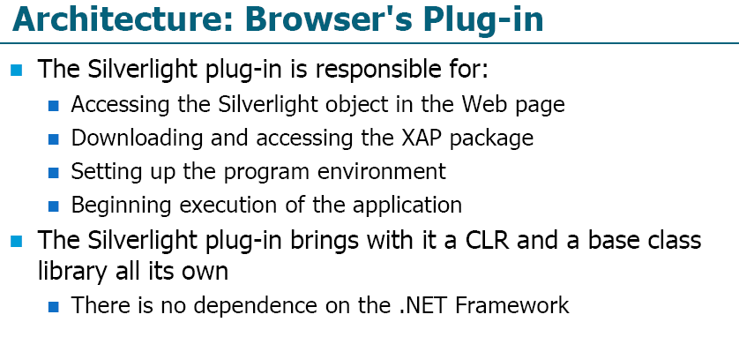
.NET: Silverlight

Slide 113
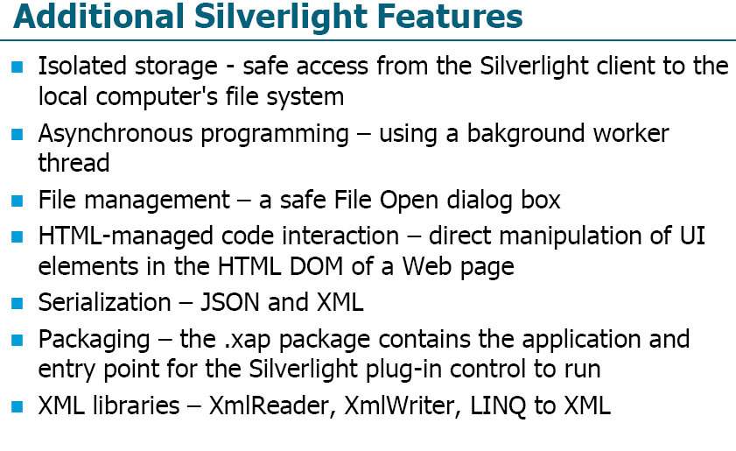
.NET: Silverlight

Slide 114
XNA, C#,
MarketPlace.
Braid.

